Slide 1

Project A-z handyman
Developer: Thien Duong
University of Houston-Downtown
Fall 2020

Slide 2
Progress since last meeting
Developed backend API for data and authentication
Developed Database Model
Improved User Interface
Added Authentication Page

Slide 3
Project Architecture (for frontend components)
GitHub repos: https://github.com/ducthien97/AZHandyMan
Folder src/:
main.js: Main controller of application
components: Components’ folder consist of all components to be rendered
ActiveUser.vue: render the laborer’ information
UserData: form to create new laborer
EditUser.vue: used to edit user data
LoginPage.vue: used to authenticate user
views: View folder consist of all views to be rendered by each route
OurWorkers.vue
Home
About
App.vue: Vue file to input data to interact with components

Slide 4
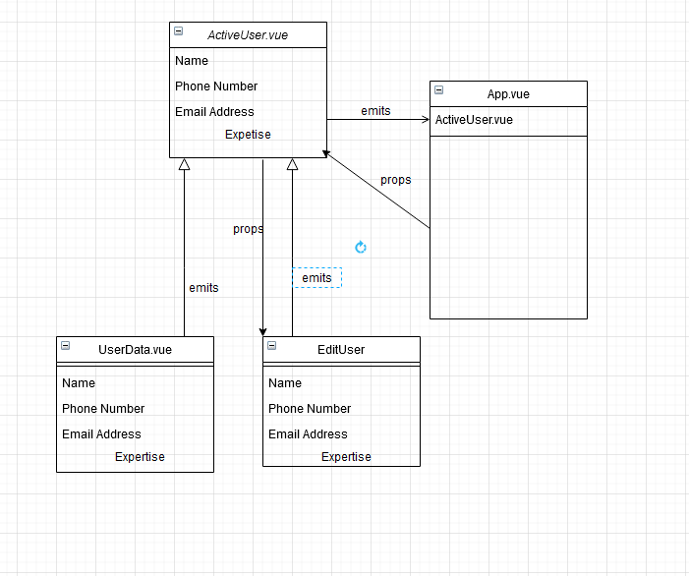
Diagram

Slide 5
Progress to be made before next meeting
Final touches on user interface components
Develop api and user interface for such as viewing specific user, more user info
Finish project paper

